Slide 1
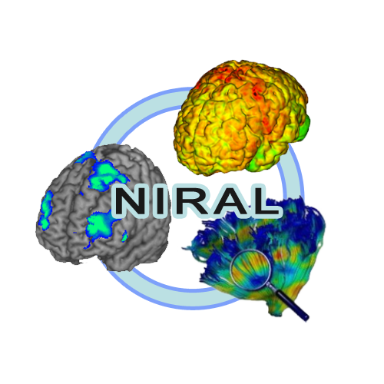


Autotract: Automatic tracking and cleaning of fibers
Presented by: Juan Carlos Prieto
Collaborators: Jean Y. Yang, Francois Budin, Martin Styner
Notes:
Autotract was developed at Neuro Image Research and Analysis Laboratory at the University of North Carolina at Chapel Hill.
Let me start by introducing Diffusion tensor image or DTI

Slide 2
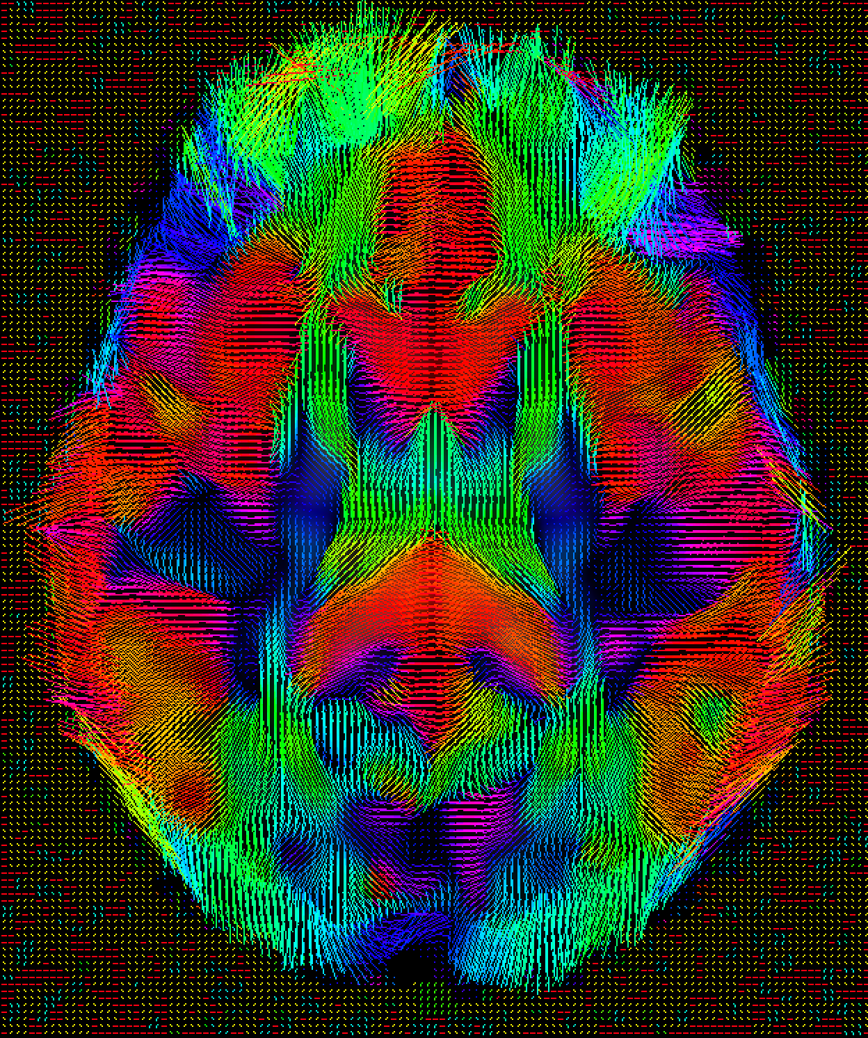
Introduction
Diffusion tensor imaging (DTI)
Measures anisotropic diffusion of water molecules in in-vivo biological tissue.
Water diffusion reveals the structure of the tissue.
Brain DTI.
Useful to understand white matter (WM) fiber structures.
Relationships between DTI measures and WM structure reveals pathologic features:
Ischemia
Myelination
Axonal damage.
Inflammation
Edema.
Axial view brain DTI visualization
coloring by direction

Slide 3
Applications
Diffusion-weighted (DW) MRI methods including DTI are powerful probes for characterizing the effects of disease and aging based on tissue structure.
Highly sensitive to changes at the cellular and microstructural level.
Applications include
Neurosurgical planning; assessment and study of neurological diseases such as multiple sclerosis or schizophrenia; brain tumor differentiation; post-surgical validation; normal brain development.

Slide 4
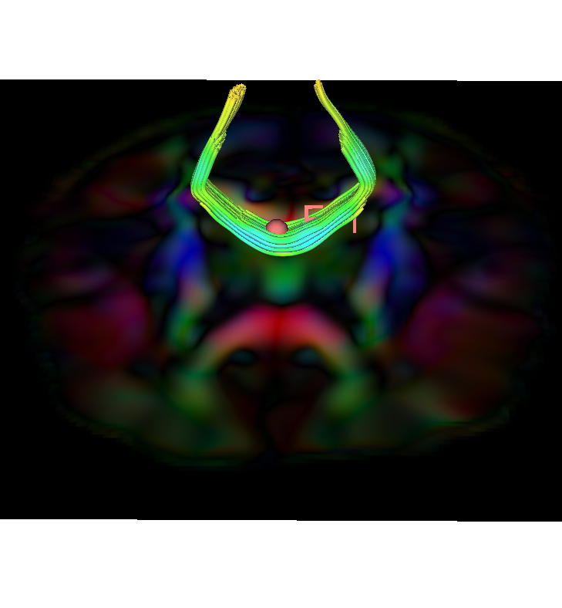
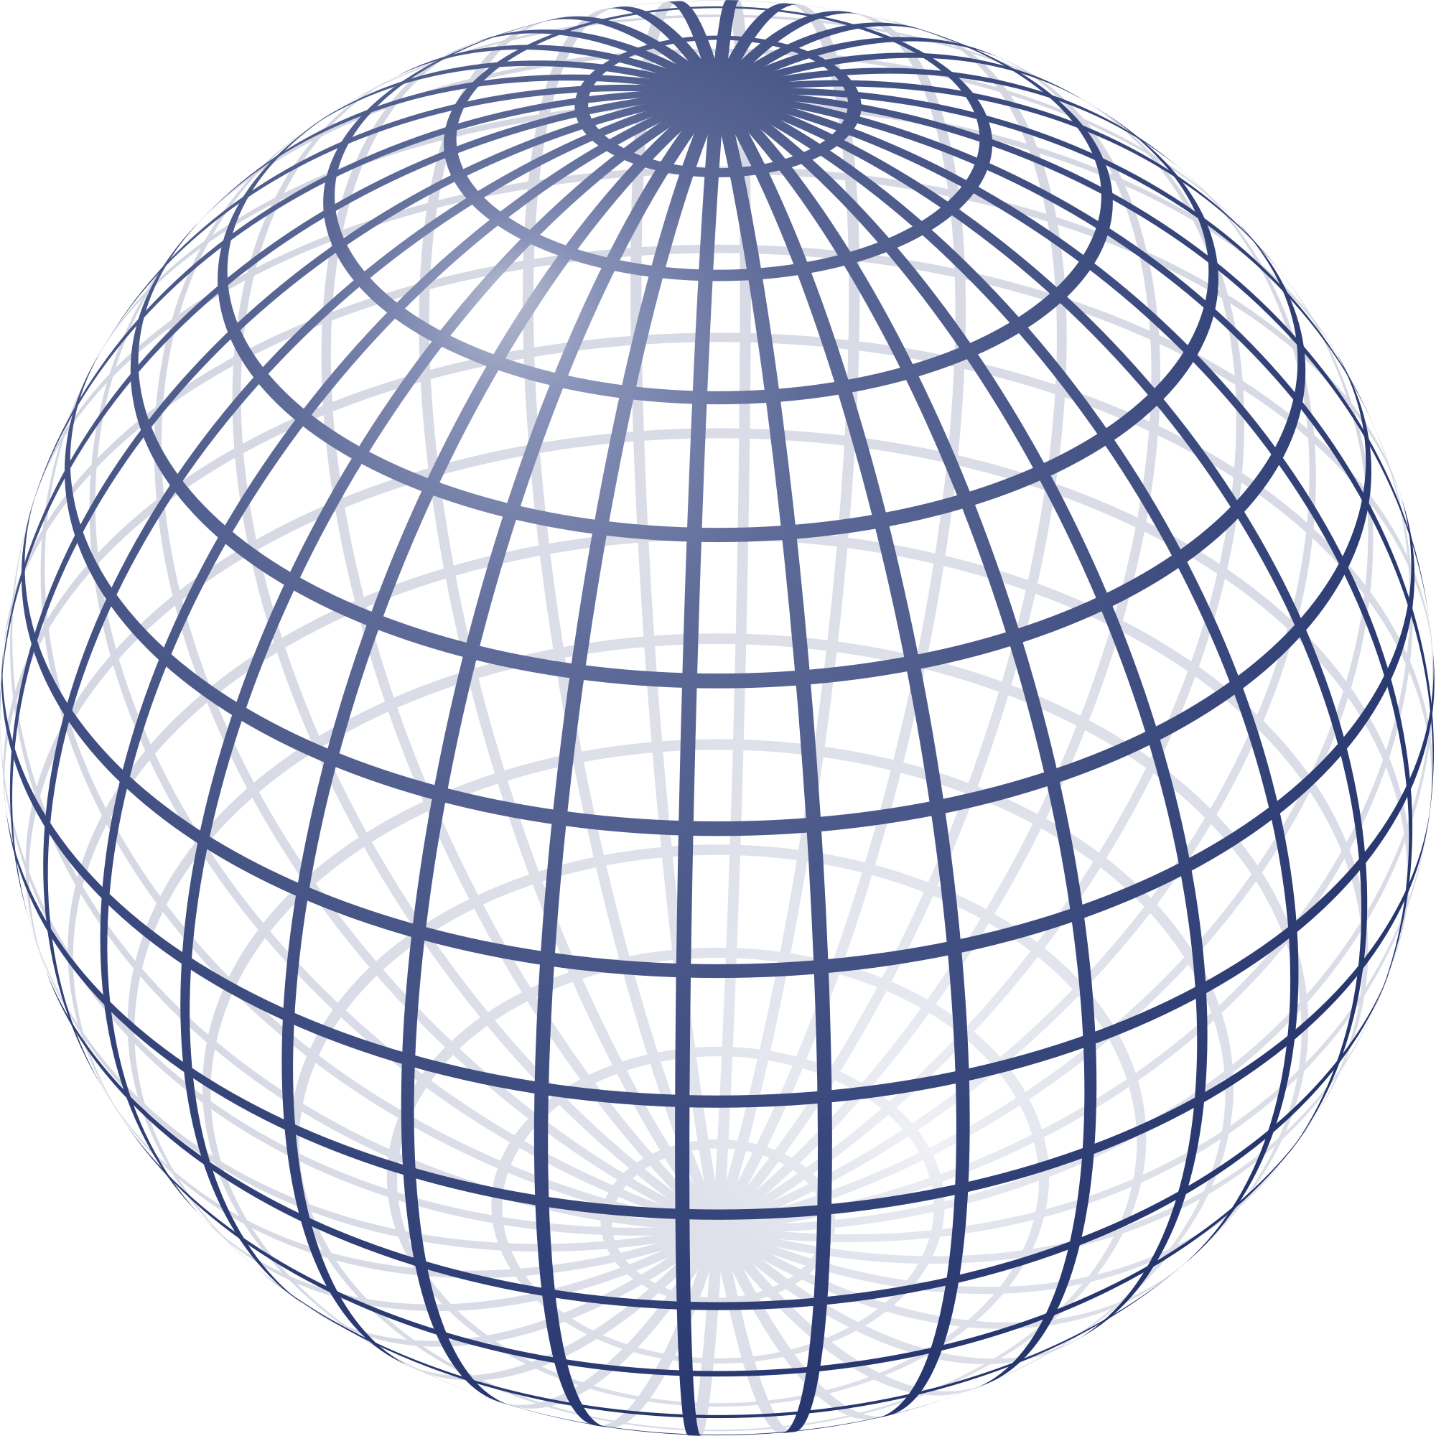
Tractography
Two main approaches
Probabilistic and deterministic.
Estimate a tract trajectory
Seed point or starting point.
Small steps in the principal diffusion direction at each voxel.
WM fiber structures
Water molecules diffuse more freely along the direction of the WM fiber.
Stopping criteria.
Fractional anisotropy (FA) [0-1];
0 means isotropic.
1 means diffusion in one direction.
Drop below FA threshold.
Deterministic
FA measurement
Notes:
Probabilistic: Describe all possible trajectories of a fiber.
Deterministic: Describe the most probable trajectory.

Slide 5
Motivation
Tractography is a time consuming operation:
An experienced user takes ~4 weeks for a full brain tractography
Additionally, cleaning and pruning fiber tracts.
Consistency
Different experts end up with different tracts.
Reduce tracking variability.
Use prior knowledge.
Tractography is an error-prone procedure.
Sensitive to initialization.
Depends on the fiber-tracking algorithm. Estimation of accurate orientations; resolve crossing of fibers, kissing, branching, etc.
Enable further clinical and research applications of tractography.

Slide 6
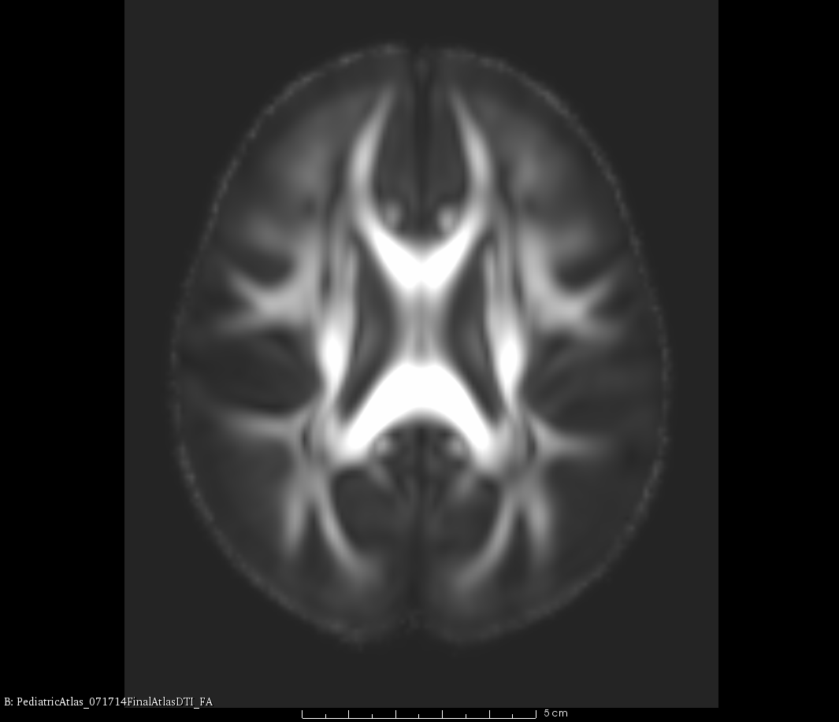
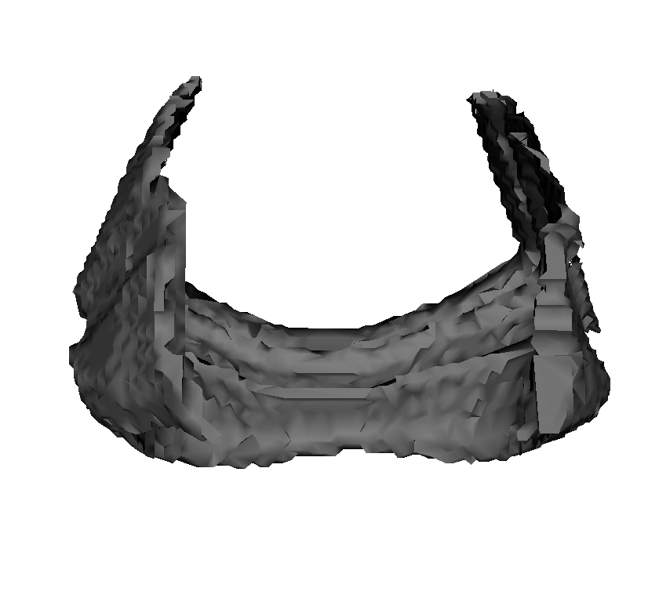
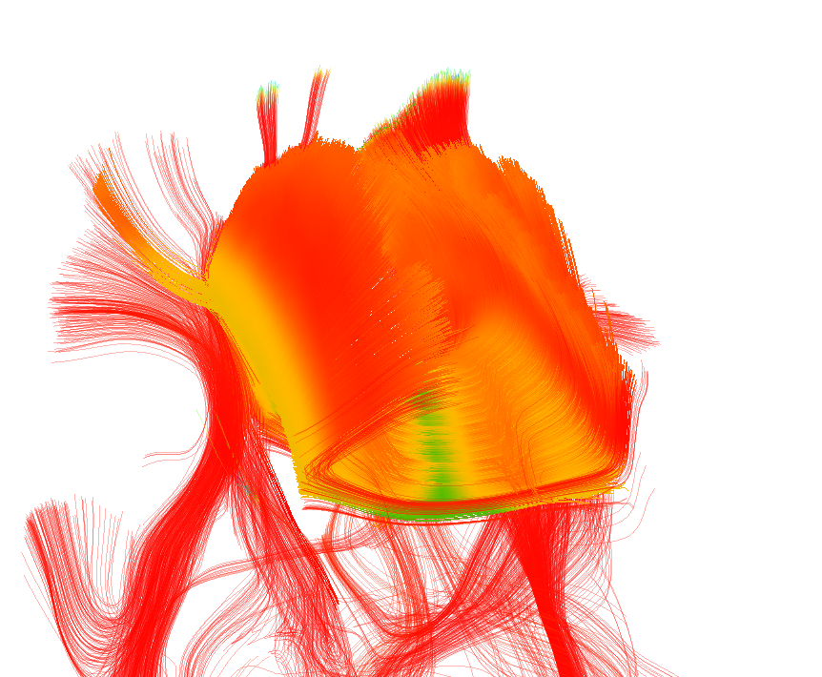
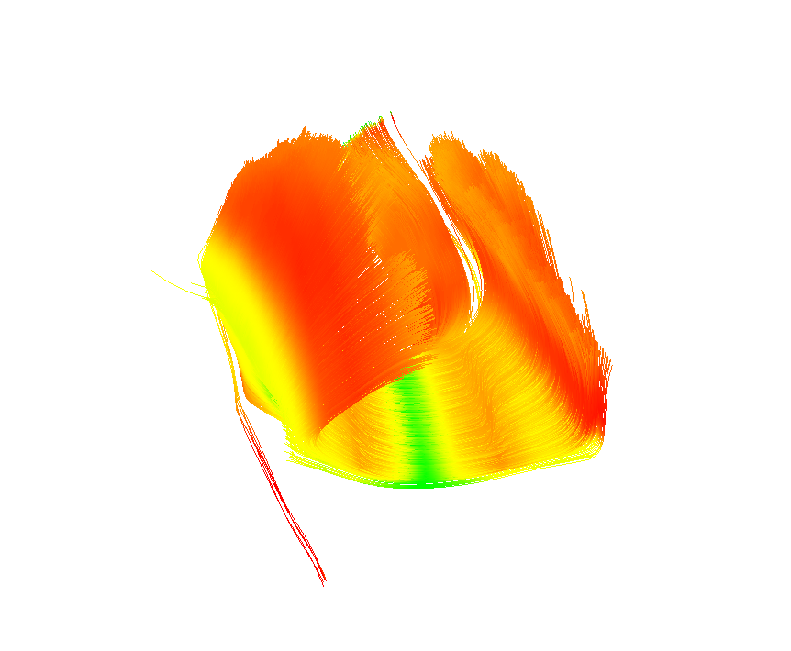
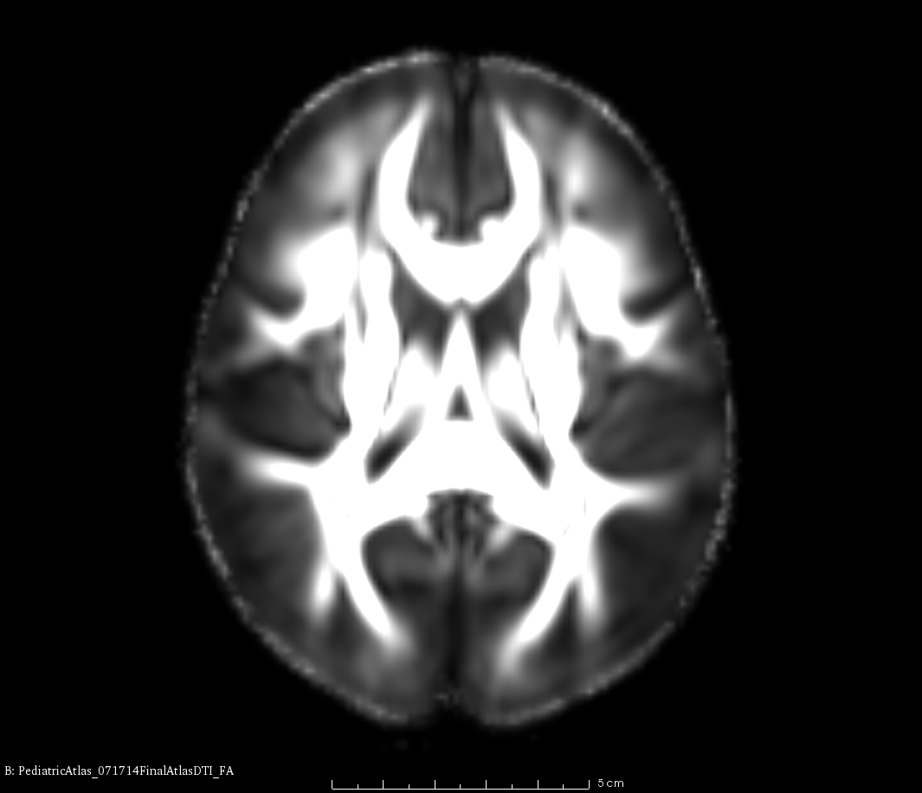
Processing pipeline
Inputs:
Source DTI and source fiber bundles (priors)
Target DTI
Optionally: WM and CSF masks (calculated using FA and Otsu threshold)
Registration
Voxelization
Tractography
Cleaning
Notes:
Make inputs/outputs explicit
Voxel + dilation

Slide 7
Registration
Compute deformation field (ANTS*)
Use the fractional anisotropy (FA) maps
Resample DTI data using deformation field
Due to the directional nature of DTIs, resampling must be done with a log Euclidean transformation
T=0
T=1
T=0.5 standard interpolation
T=0.5 log Euclidean
*http://picsl.upenn.edu/software/ants/
Notes:
Standard interpolation methods would result in losing the structural information of the image. The interpolation is done using Log euclidean resampling with preservation of strain.

Slide 8
Tractography
Source input fiber bundles are transformed to label maps.
Used as seed points to initialize tractography.
The tractography algorithm is based on the second-order Runge-Kutta method.
Take small steps along the principal diffusion direction.
Tracking stops when the FA drops below a threshold value (default is 0.1) or when fiber direction changes rapidly.
Notes:
2. Tractography was performed by following small steps along the principal diffusion direction
3.
Concise s
Standart deterministc tract

Slide 9
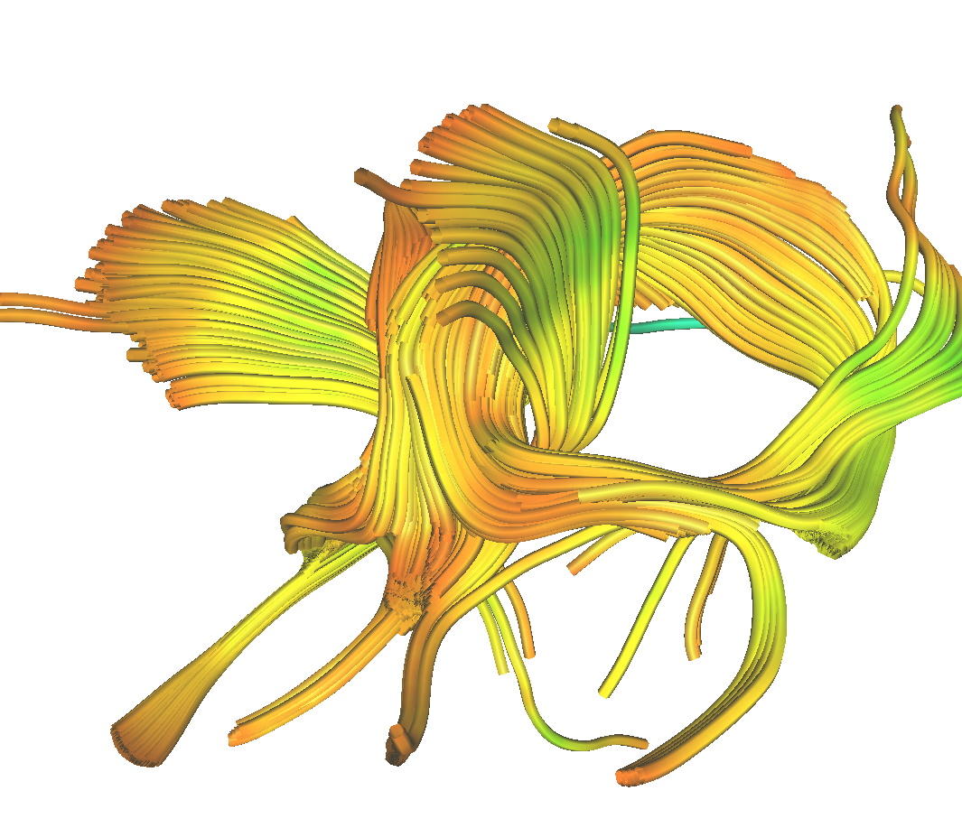
Fiber cleaning
Morphological operations
Dilated WM
Eroded CSF
Crop fibers outside of the WM region.
Crop fibers going through CSF region.
Source – Autotract -> 60% overlap
Source fiber bundle length to detect outliers in the newly traced fibers.
Check if localized regions in the fiber do not deviate more than 10 mm from the source bundle.
Notes:
The WM region can be provided as input to Autotract or it is calculated using the FA map and thresholding with Otsu’smethod.
The CSF mask can also be provided as input or it is generated with a multi Otsu threshold segmentation.
Specifically, the FA is divided into three clusters and the CSF is considered to lie in the first cluster.
The fibers are pruned according to following criteria:
Source => Fiber atlas,
User provide CSF and WM is best -> Automatic mask creation for CSF and WM

Slide 10
Experiment materials
Source atlas DTI:
An atlas is generated with DTI data from 86 neonate infants data acquired at UCIrvine.
This atlas has WM fiber bundles previously determined by an expert.
Target DTI atlas:
DTI data from 100+ healthy infants (1 year and 2 years).
Validation:
This atlas has a set of fiber bundles previously traced and validated by an expert. Ground truth (GT)
Autotract VS. GT
Inputs
Source DTI atlas
Source atlas fiber bundles
Target DTI
Outputs
1. Autotract target DTI fiber bundles
Validation:
Ground truth data vs. Autotract
Notes:
Use propagated source bundles to generate new tracts in the ground truth DTI data.
University of California, Irvine

Slide 11
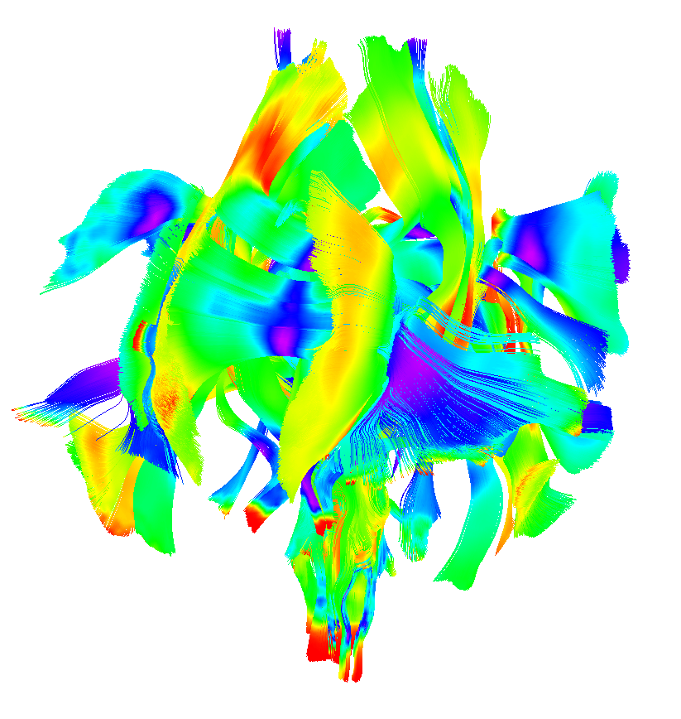
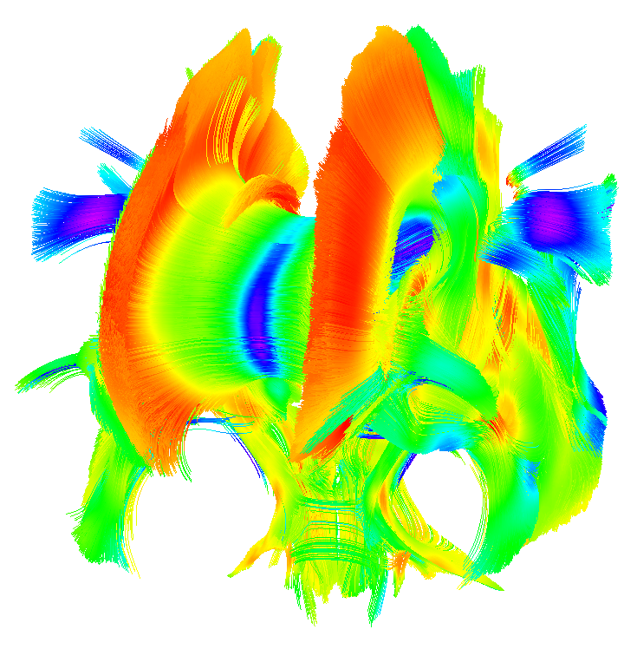
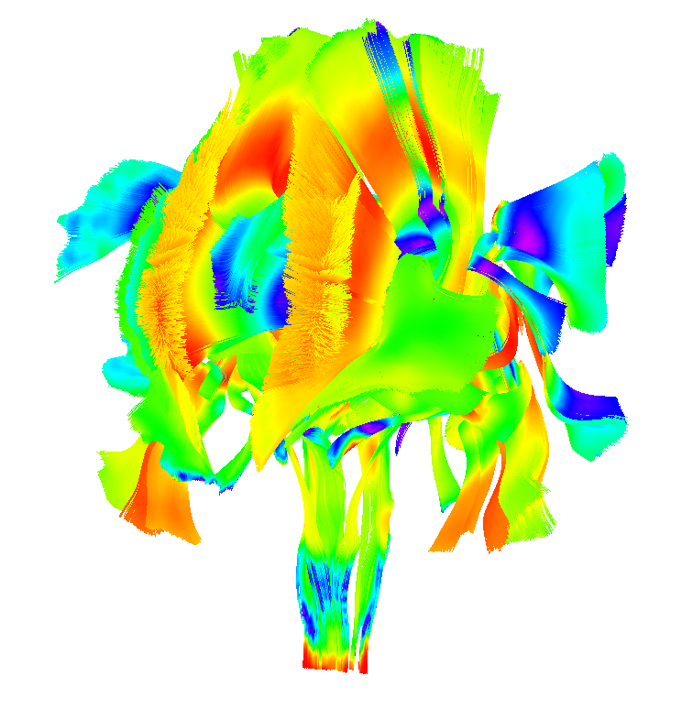
Results
Source atlas fibers
Autotract
Ground truth on target
Notes:
Coloring FA

Slide 12
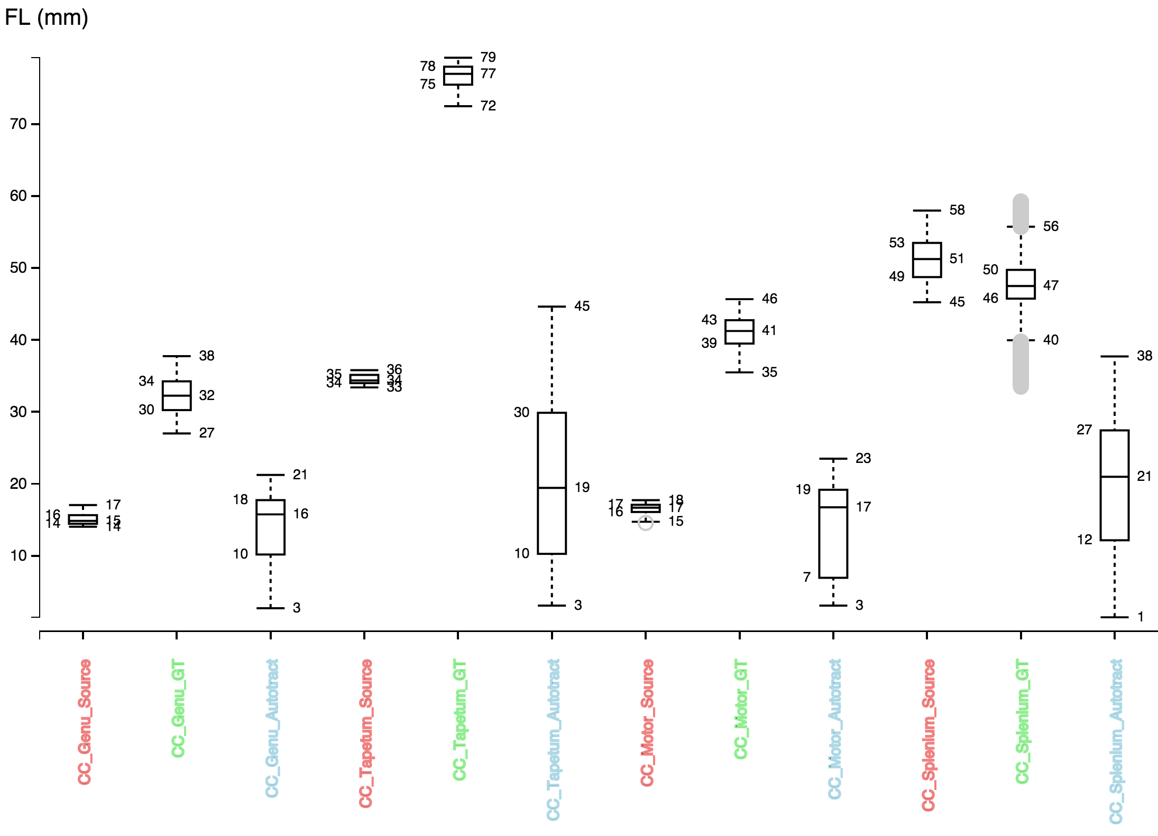
Fiber bundle length – Box plots
Red – source, Green – GT target, Blue – Autotract
Source bundles -> Tight distributions
GT bundles -> longer and looser distribution
Autotract -> looser but includes source distribution
Notes:
A box plot shows
25th percentile. Splits the lowest 25% of data from the highest 75%)
50th percentile or median (cuts data set in half)
75th percentile, splits off the highest 25% of data from the lowest 75%
And we can also see the outliers

Slide 13
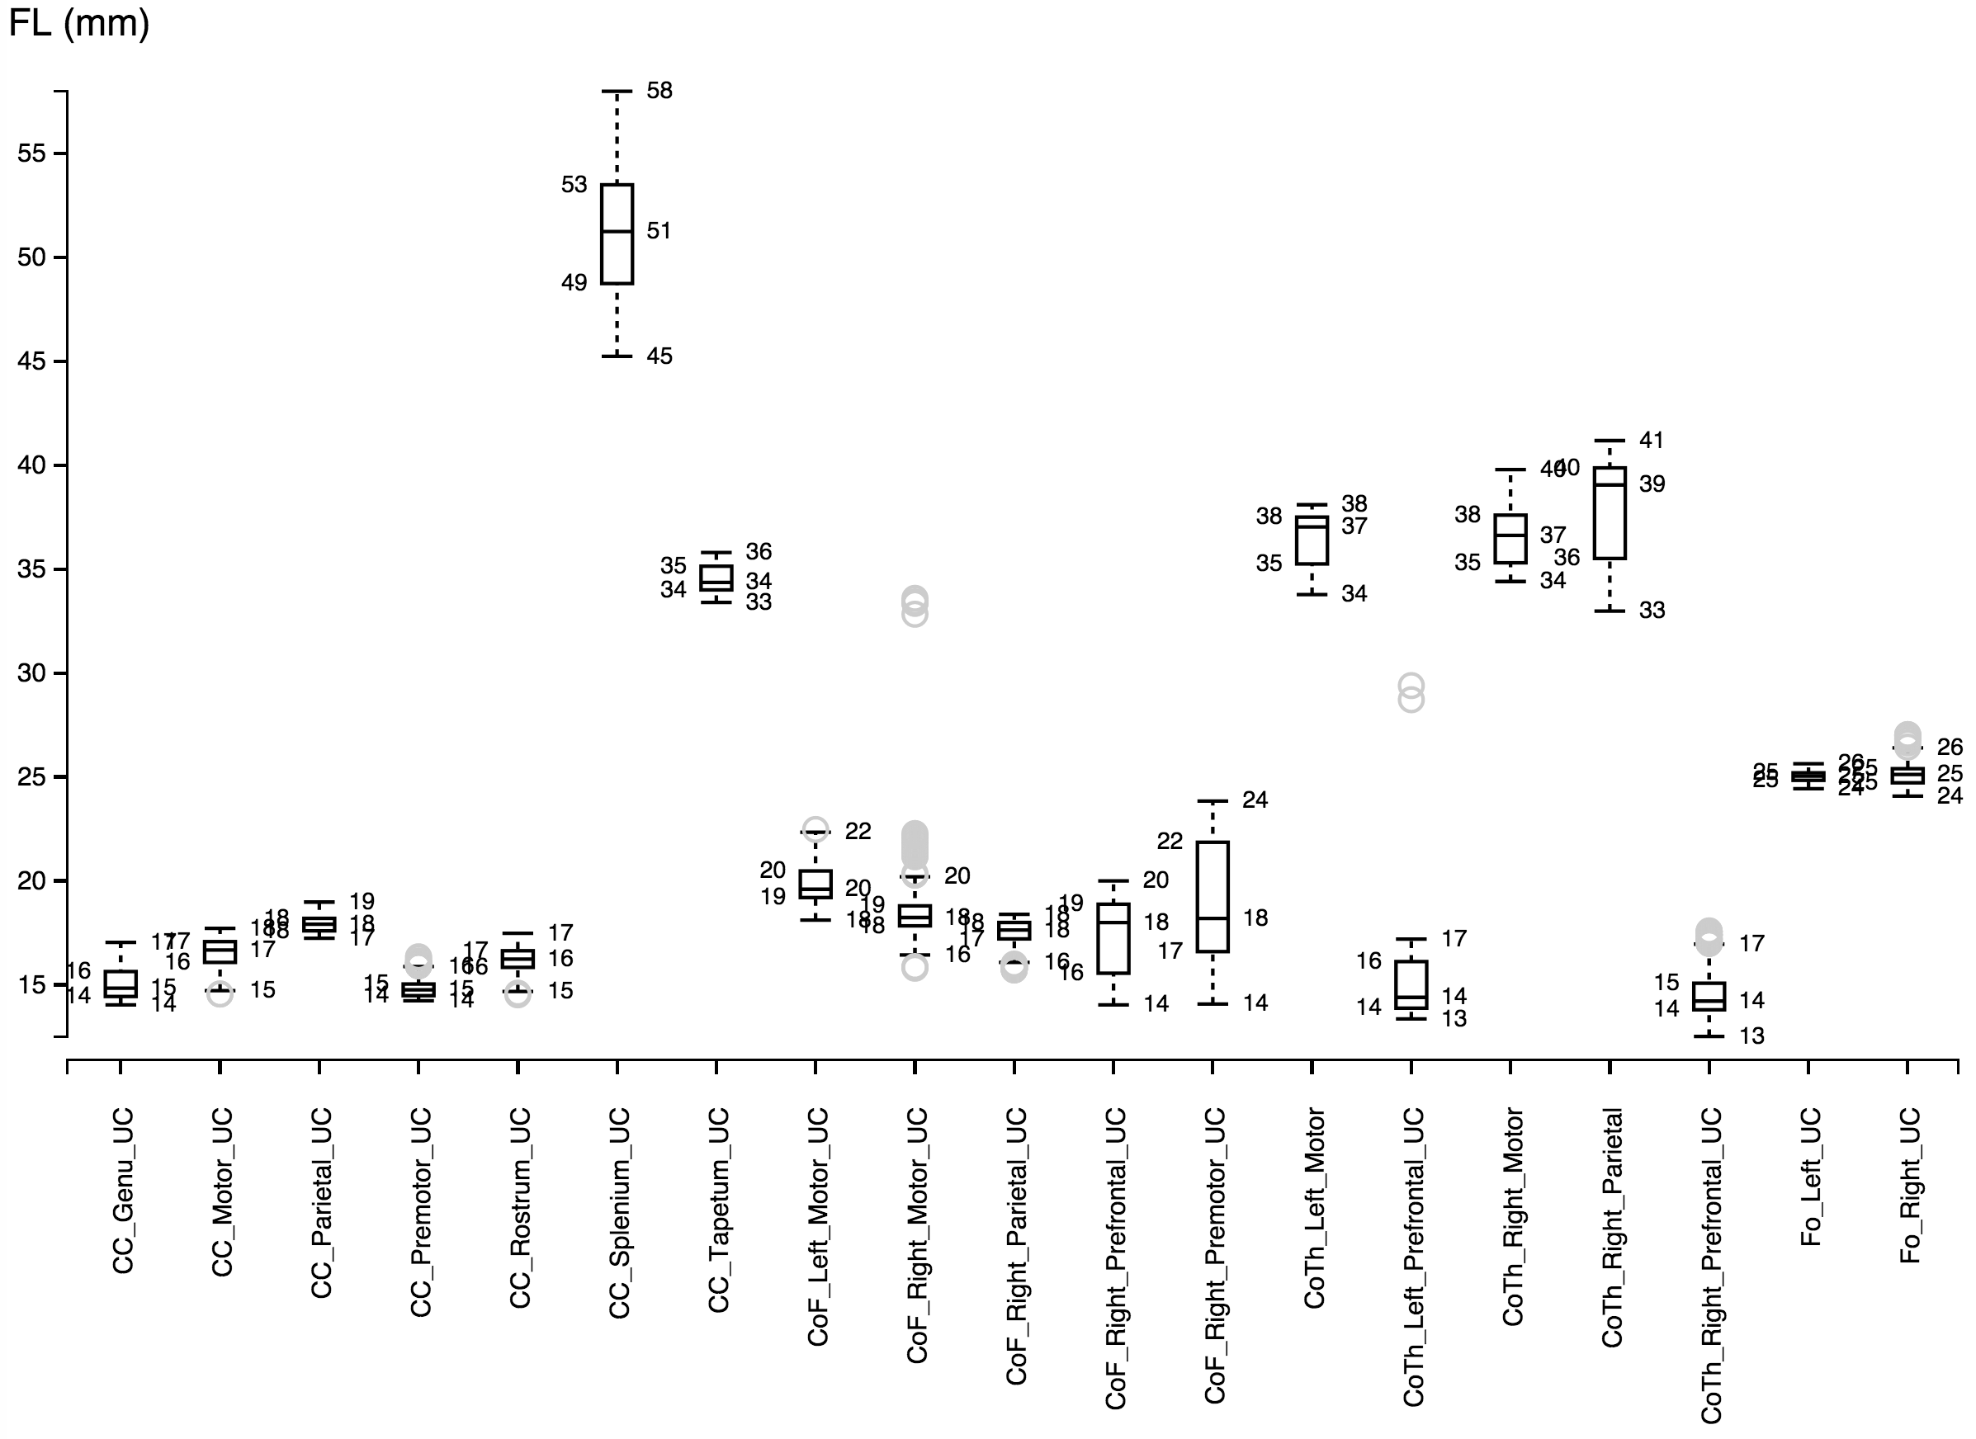
Source fiber bundles

Slide 14
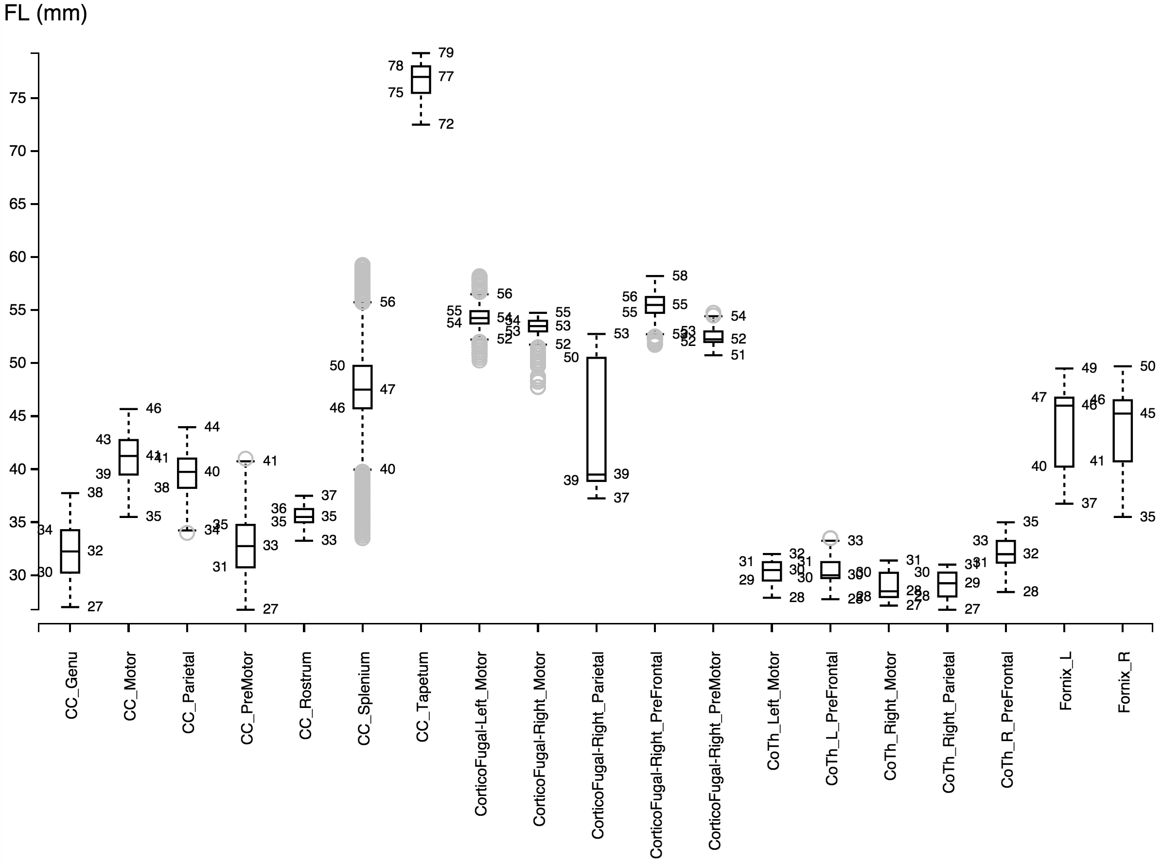
Ground truth

Slide 15
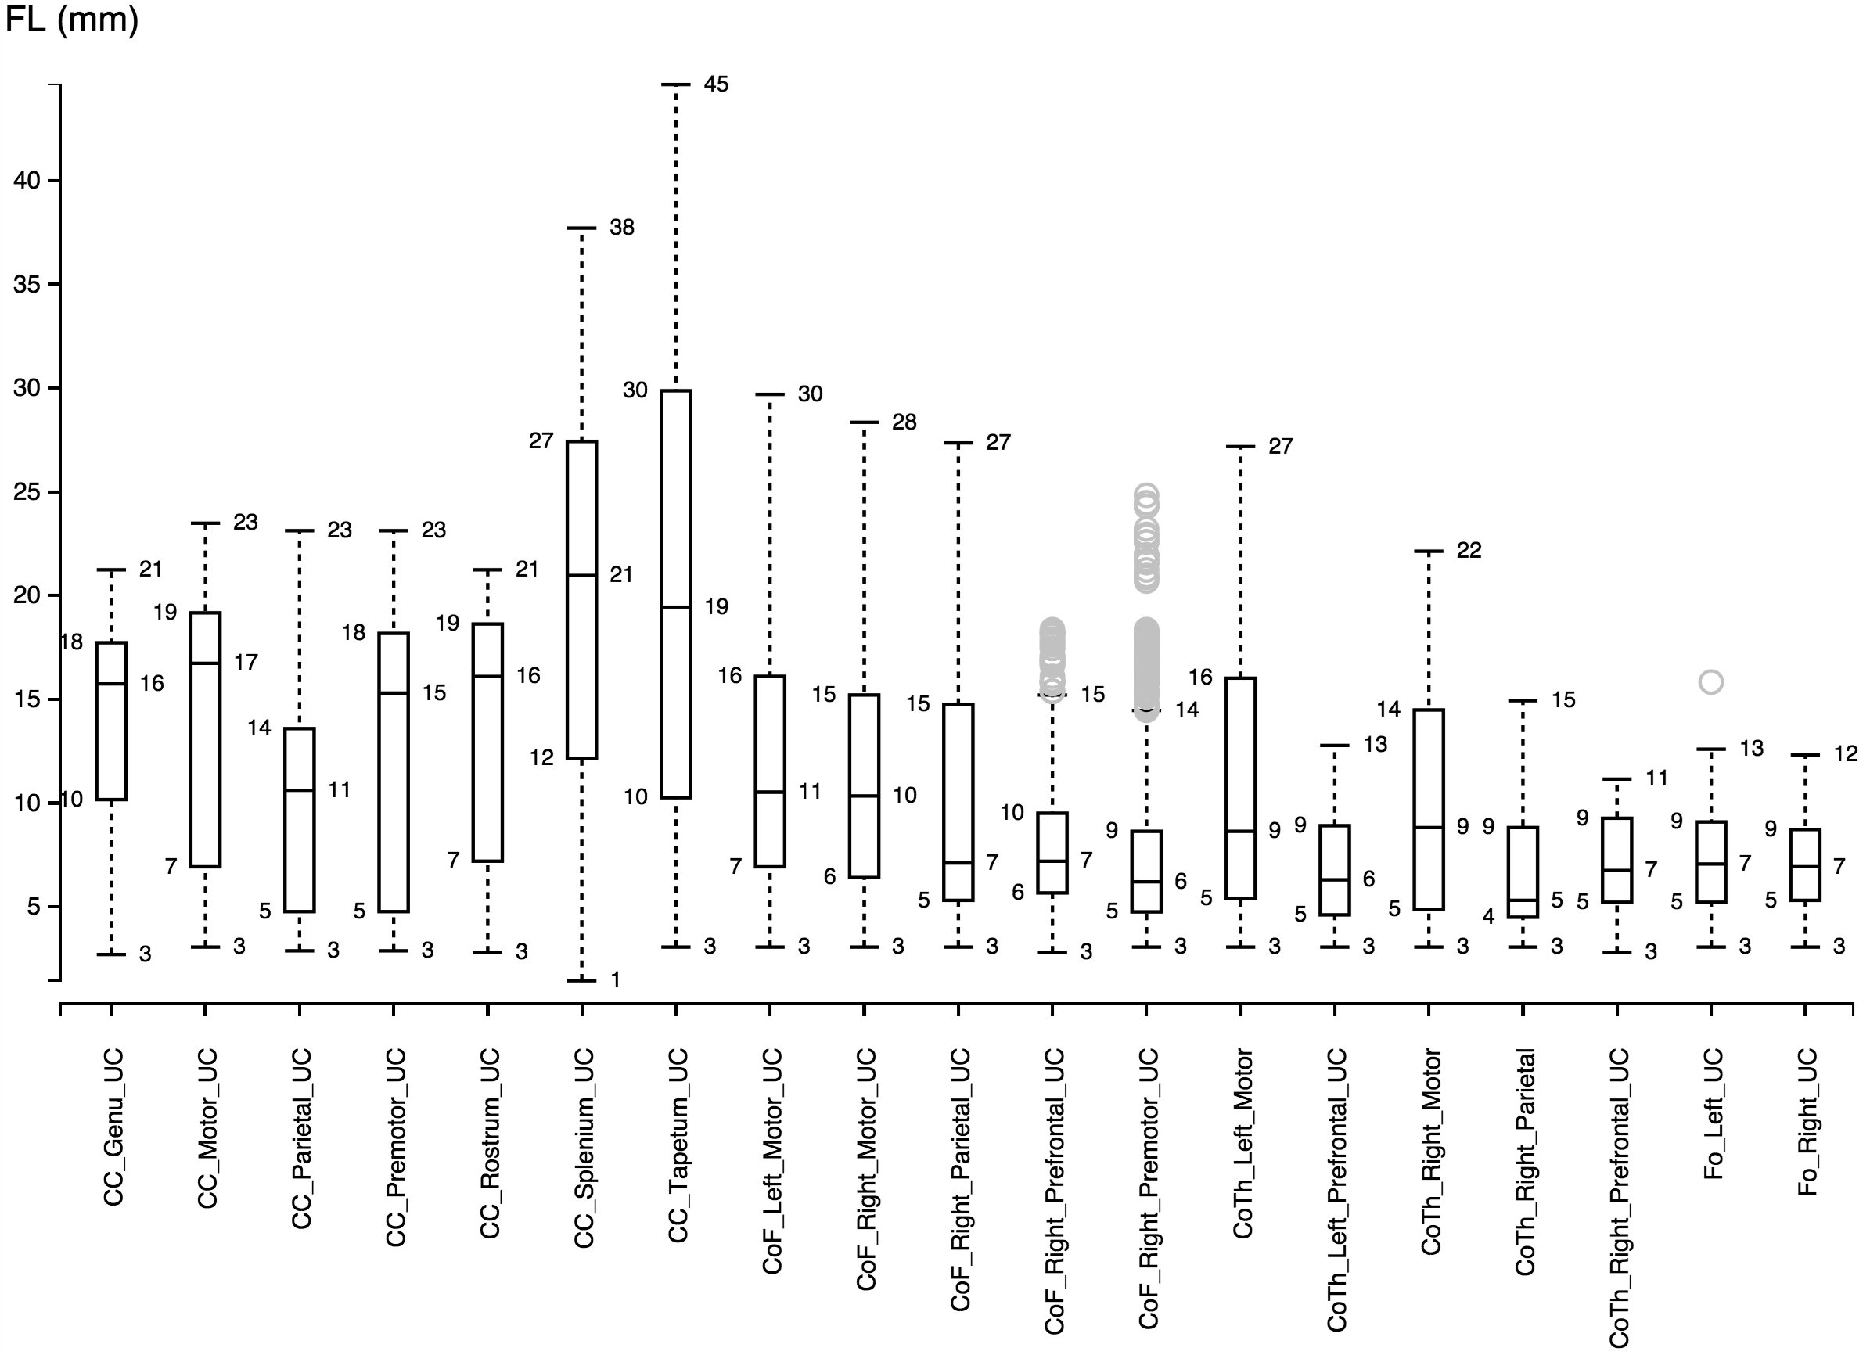
Autotract

Slide 16
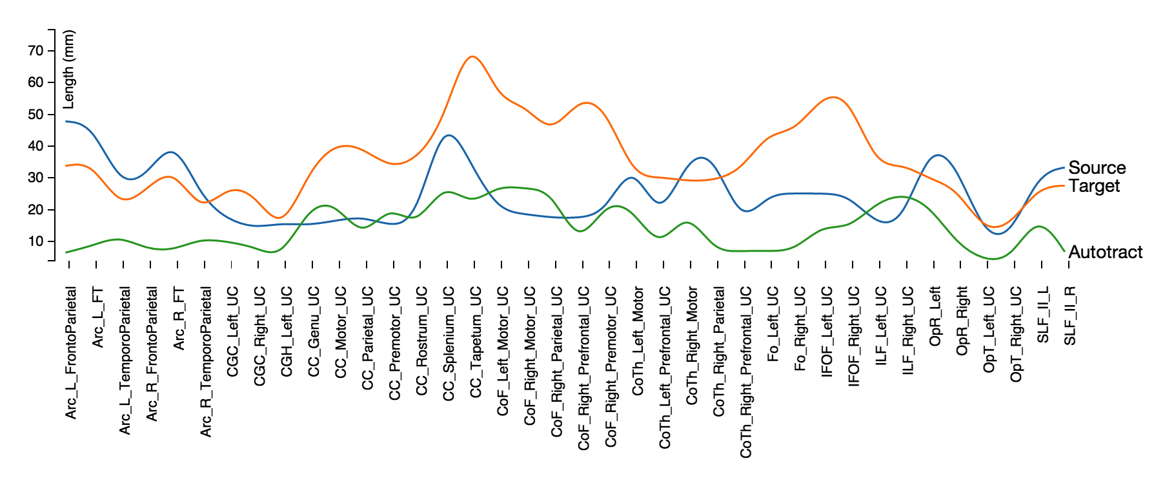
Average bundle length
GT target bundles are much larger than source atlas bundles (two experts)
Autotract bundles are shorter.
Positive correlation between GT target and Autotract

Slide 17
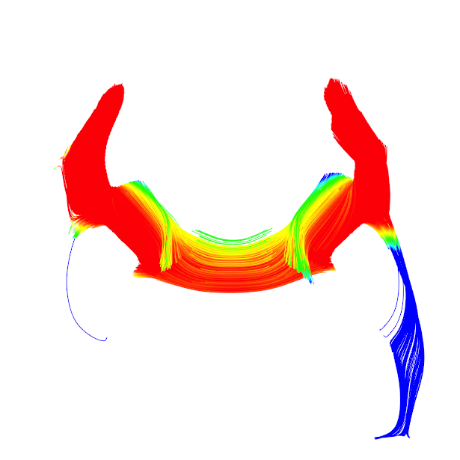
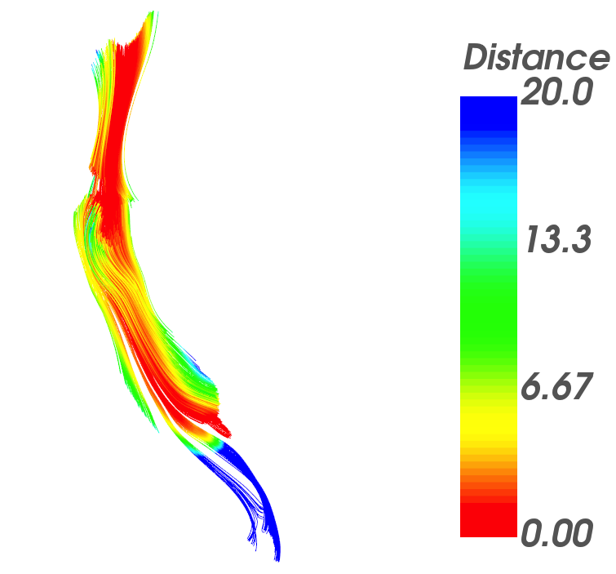
Minimum distance GT vs Autotract
mm
Corpus callosum Genu
Cortico thalamic left motor
Similar fiber lengths.
Investigate new approach to crop fibers and stop tracking.
Notes:
Distance in (mm) mapped to a unique color described by the color bar to the right of each figure. Each fiber traced by Autotract is compared against the corresponding ground truth bundles. The bundles shown are the output of Autotract.

Slide 18
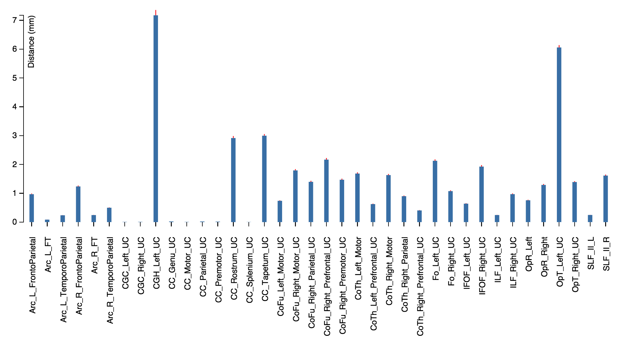
Average fiber distance GT vs Autotract
Average bundle distance in average is less than 4mm
MAD shows tight distribution.
Notes:
Median absolute deviation

Slide 19
Conclusions
Autotract is a fully automated tool for fiber tracking and cleaning.
Uses prior knowledge from fiber bundles previously traced.
Approach demonstrated for a wide variety of brain structures.
Save time from the tedious procedure of cleaning and validating fiber tracts for different brain regions.
Enable new possibilities for research applications
Statistical white matter analysis using tractography.
Neuroscientific hypotheses regarding group differences.
Future work
Optimize the approach to achieve similar fiber lengths.
Investigate a new strategy to crop fibers based on shape descriptors; different similarity metrics; improving stopping criteria for tractography.
Improvements to this framework could lead to a fully automated approach for tractography.
Notes:
Download and use the tool.
Use the tool as a first draft.

Slide 20
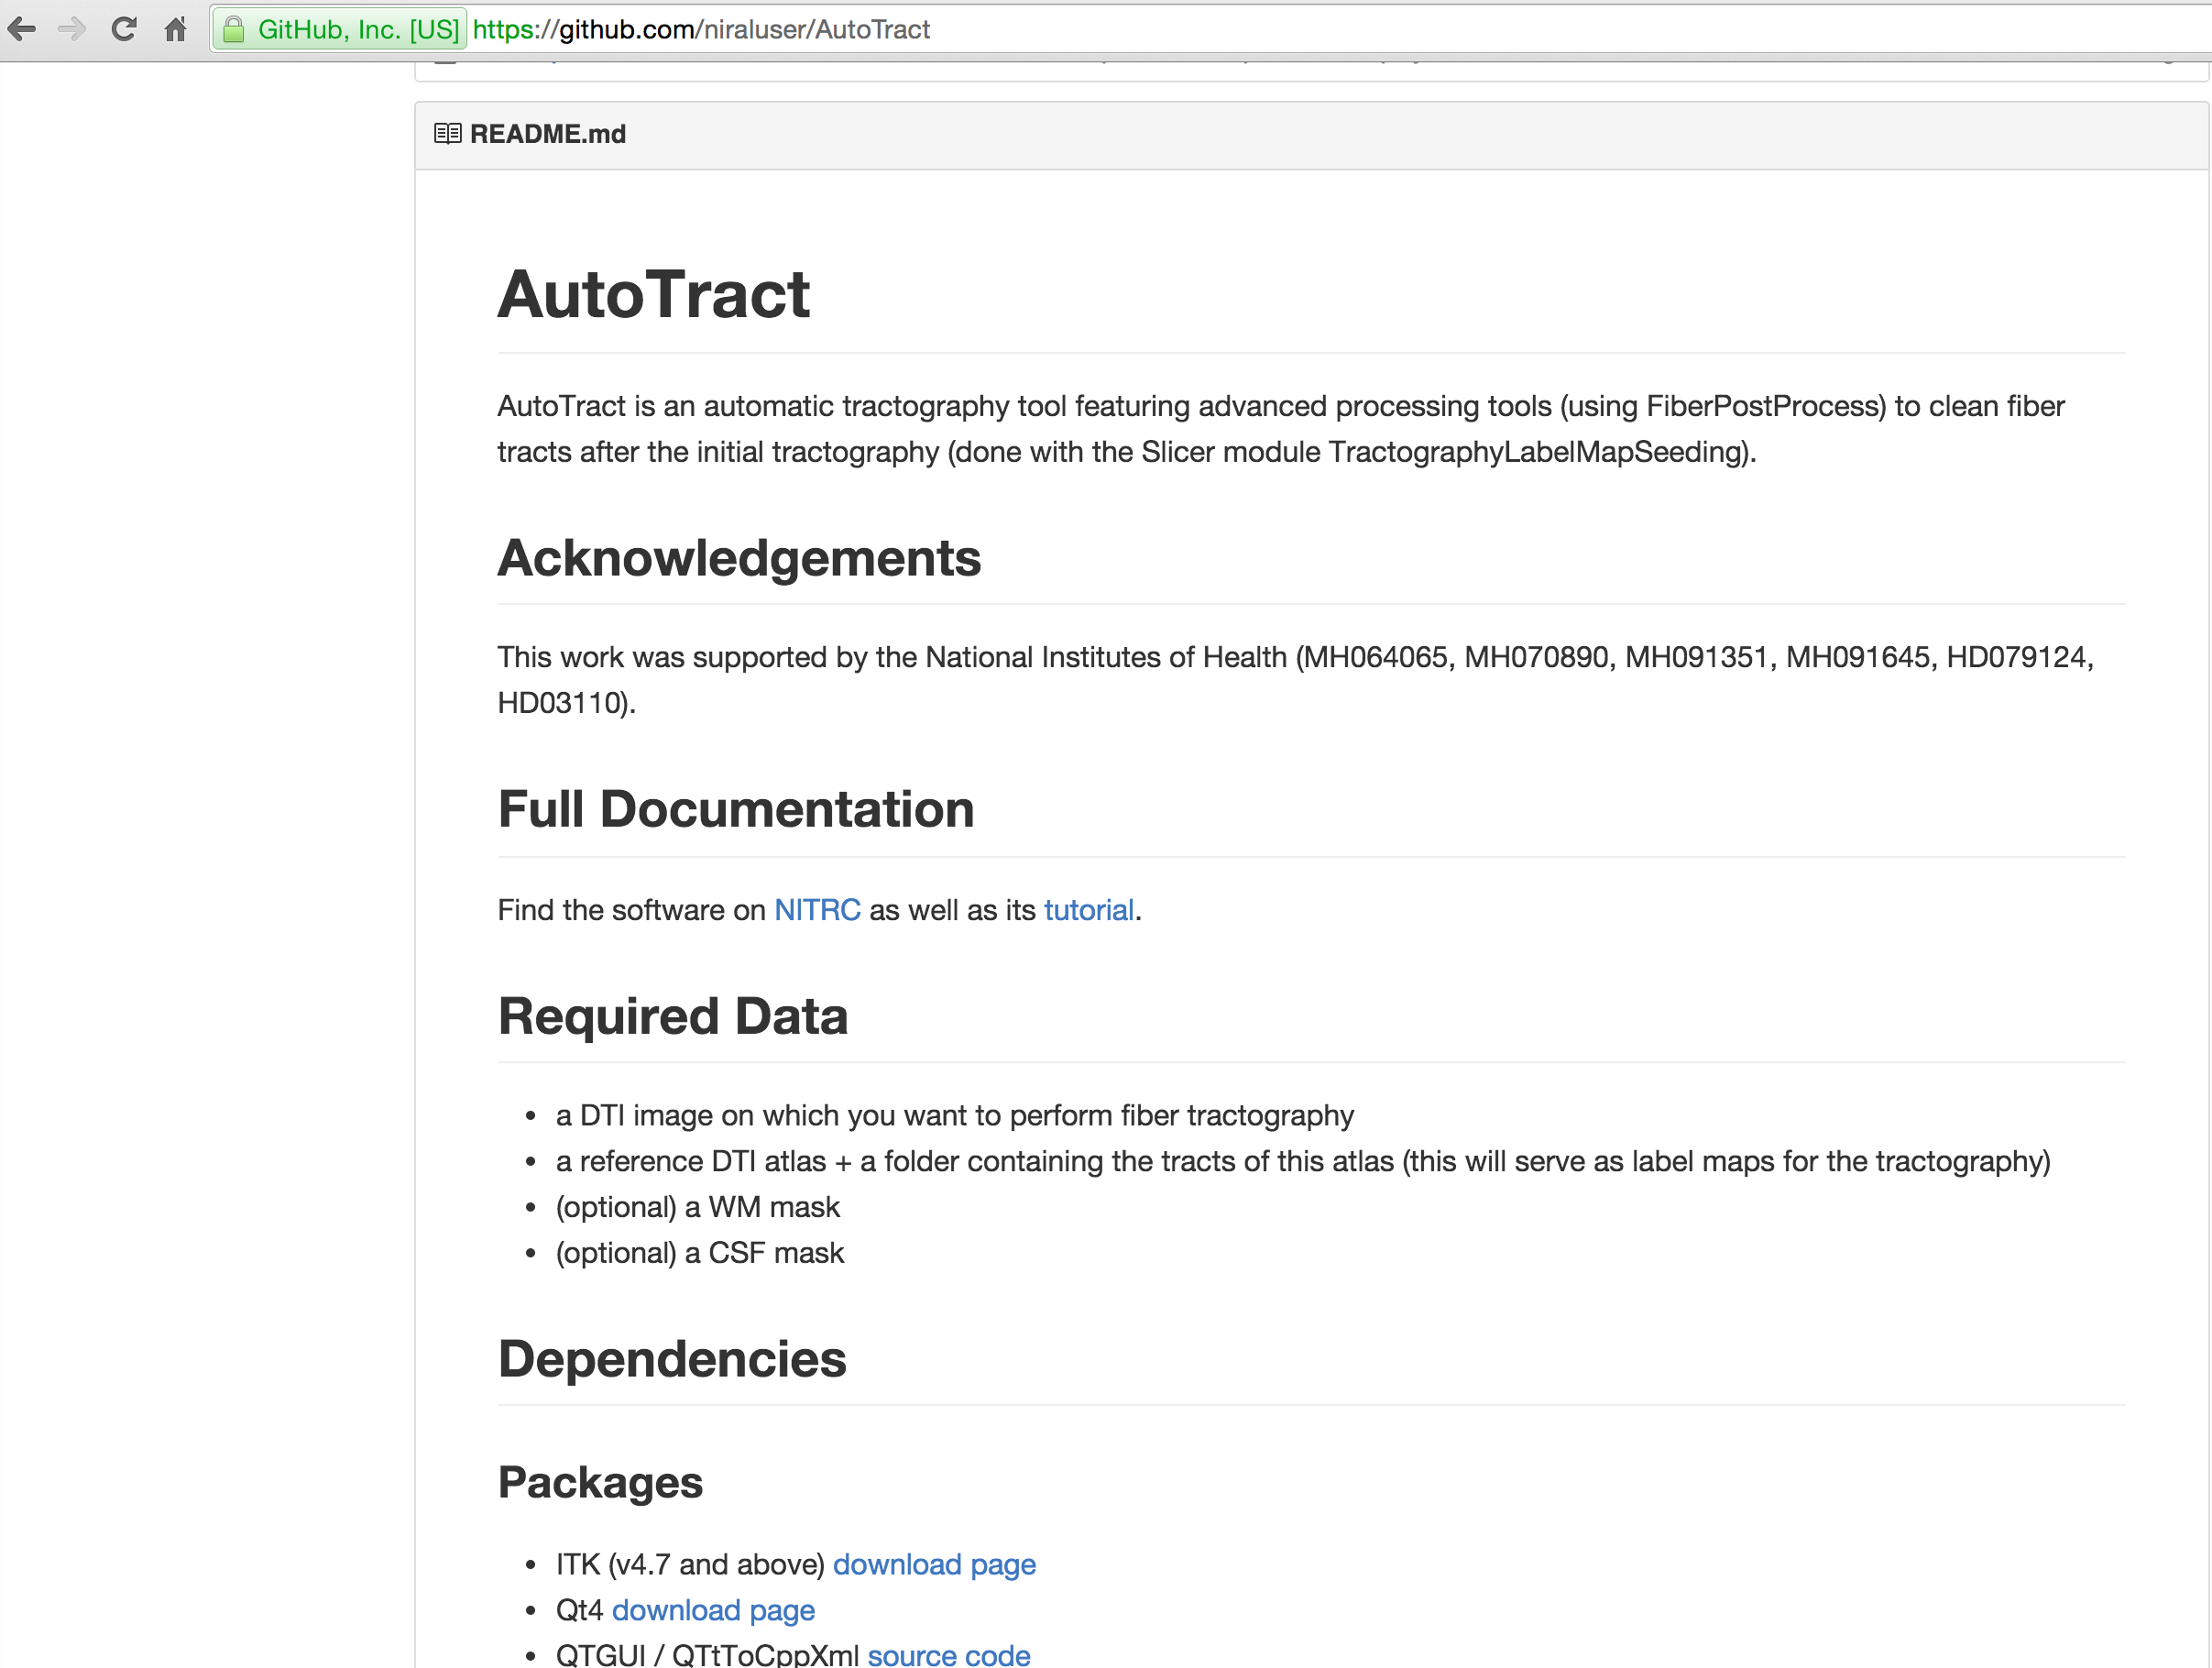
Tool available for download
www.github.com/NiralUser/Autotract

Slide 21
Thank you for your attention
Questions?

